Slide 1
Business Presentation

Slide 2
Contents
In this presentation, we are going to investigate about refurbished and used cell phone market.
Buying and selling used smartphones used to be something that happened on a handful of online marketplace sites. But the used and refurbished phone market has grown considerably over the past decade, and a new IDC (International Data Corporation) predicts that the used phone market would be worth $52.7bn by 2023 with a compound annual growth rate (CAGR) of 13.6% from 2018 to 2023. This growth can be attributed to an uptick in demand for used smartphones that offer considerable savings compared with new models.

Slide 3
Business Problem Overview and Solution Approach
The rising potential of this comparatively under-the-radar market fuels the need for an ML-based solution to develop a dynamic pricing strategy for used and refurbished smartphones.
We as data scientist are going to analyze the data which is provided by ReCell and build a linear regression model to predict the price of a used phone and identify factors that significantly influence it.

Slide 4
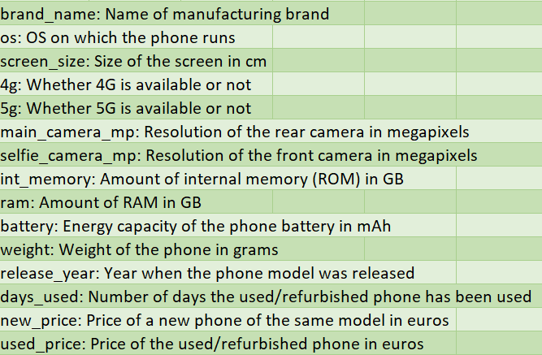
Data Overview
We have a data with 3571 rows and 15 columns
Some columns have missing values.
Also, we have outliers in our data
os column has 4 unique values
4g and 5g have 2 unique values
brand_name has 34 unique values
release_year rang from 2015 to 2020
The average of used_price is 109.880 euro
Columns brand_name, os, 4g and 5g need to be dummy variable.
Also, 4g and 5g have overlapping so, I tried to apply a feature engineering to have in a new column called "4_5g“ containing 3 possible values: 5g, 4g, and Other.

Slide 5
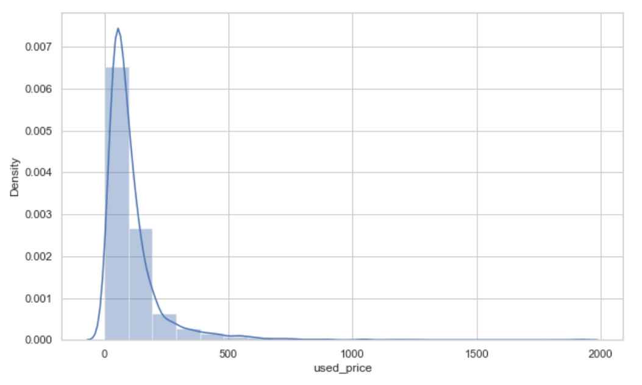
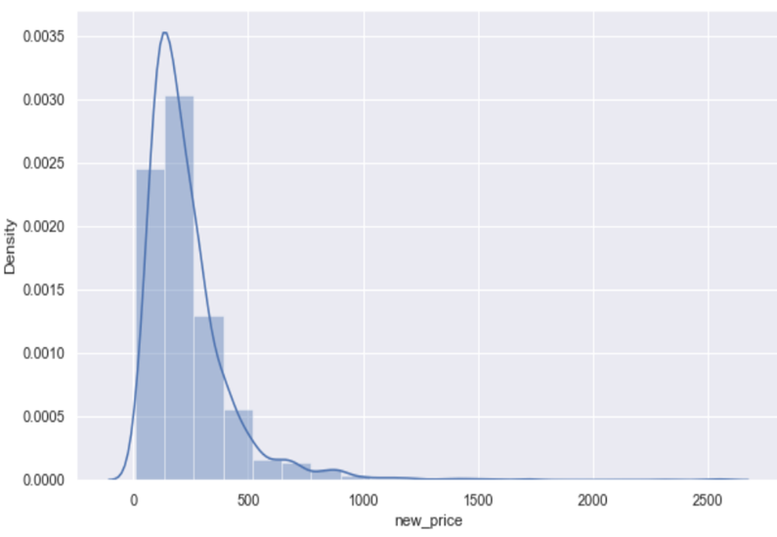
EDA
Used_price and new_price are highly skewed to the right so; I used log transformation to make their shape better and look like a normal distribution.

Slide 6
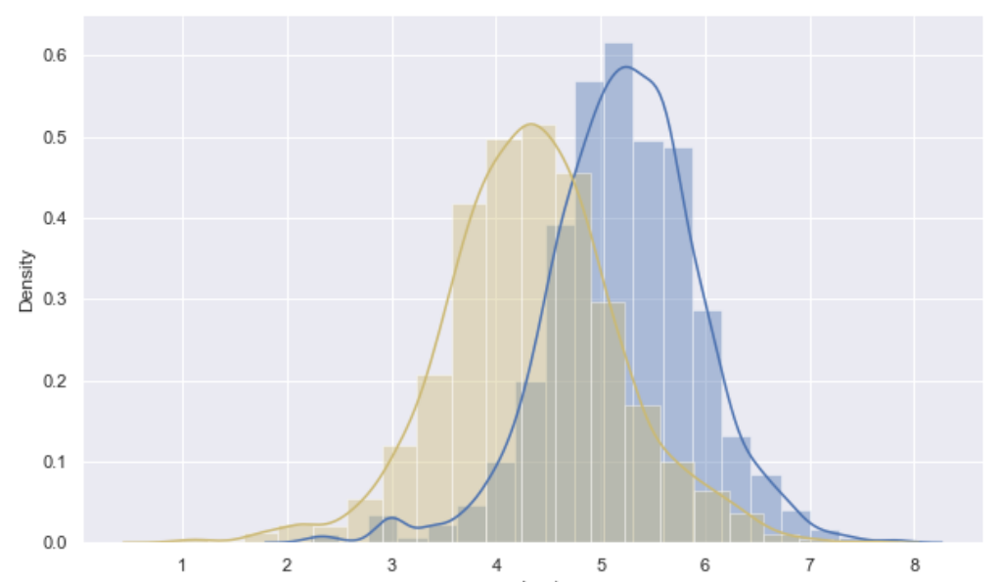
EDA
Distribution of columns new_price and used_price after log transformation
it seems that Log transformation is helpful in reducing the skewness. the blue one is related to new_price and yellow is related to used_price.

Slide 7
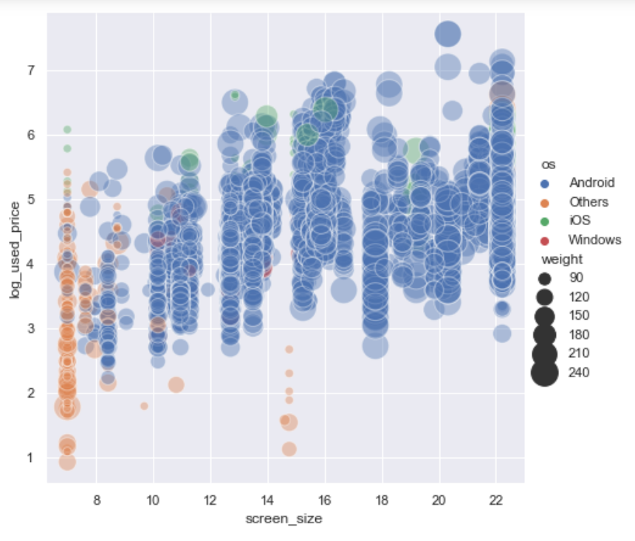
EDA
it seems that heavy cell phones have a bigger screen, and a bigger screen does affect the price.
Android is much more than other [os] which is showing very well in this plot.

Slide 8
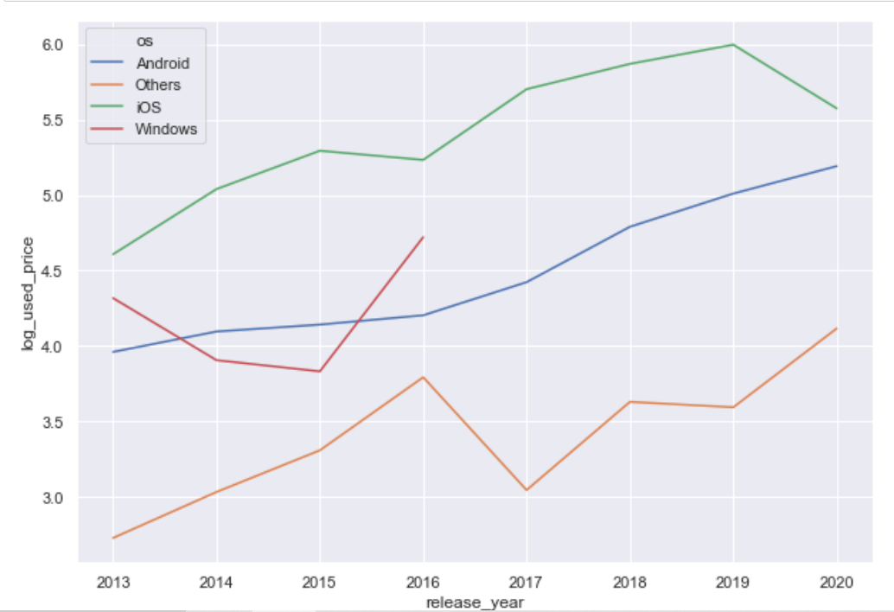
EDA
The price of ios and Android were going up till 2019 but then ios is coming down. Also, the Others [os] are going up.
Windows stop producing in 2016.
Totally it is acceptable that the recently released cell phone has a price higher than the old released.

Slide 9
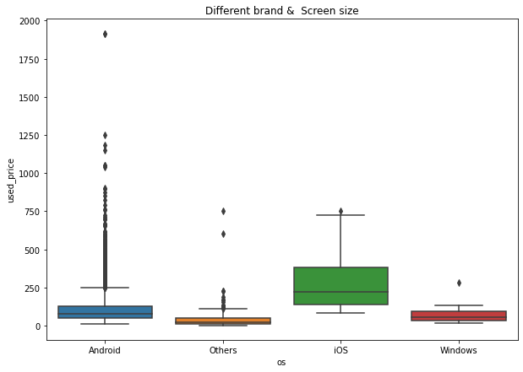
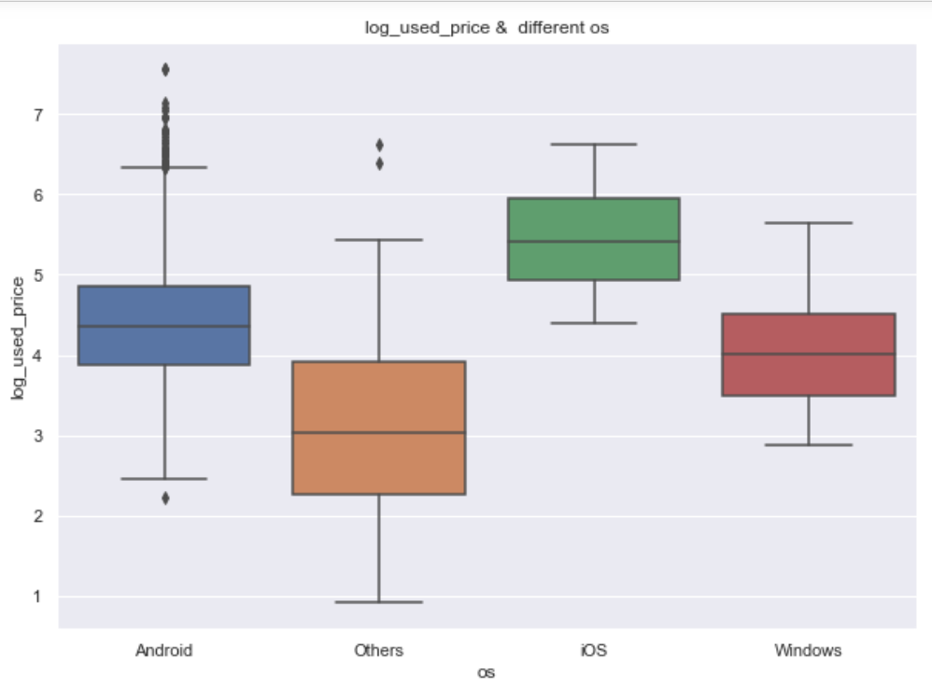
EDA
after dealing with missing values and outliers they seem better than before. their skewness is less with lower outliers which are not shaped the distribution.

Slide 10
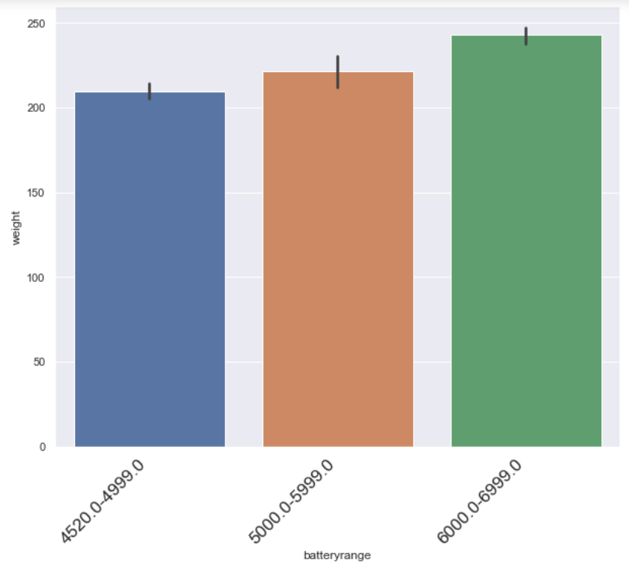
EDA
How does the weight vary for phones offering large batteries ( more than 4500 mAh )?
I started with filtering the data base on mAh >4500 and get their means
for best understanding I categorized battery column to 3 groups and then got a bar plot
cellphones with highest weight have larger batteries

Slide 11
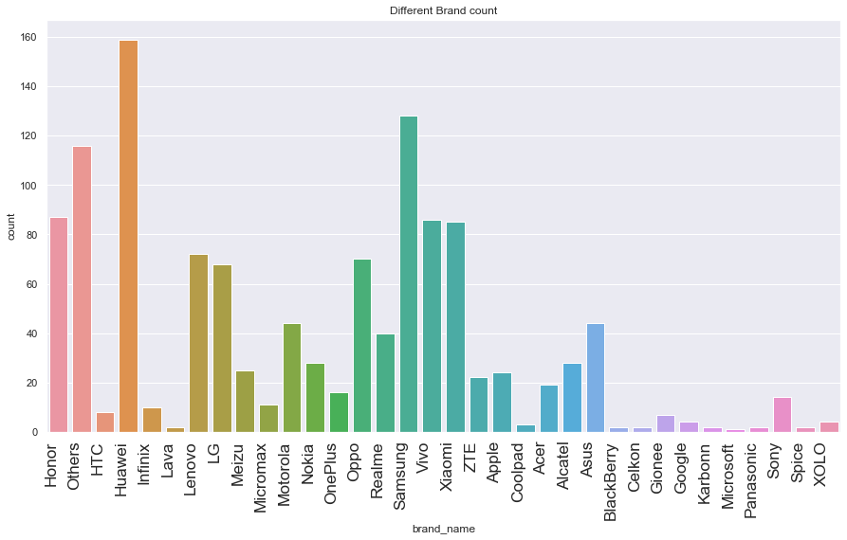
EDA
How many phones are available across different brands with a screen size larger than 6 inches?
between all brands, Huawei and Samsung cell phones are more than other brands which have screen sizes bigger than 6 inches (159 and 128) also, we have Other category which is located after them(116)

Slide 12
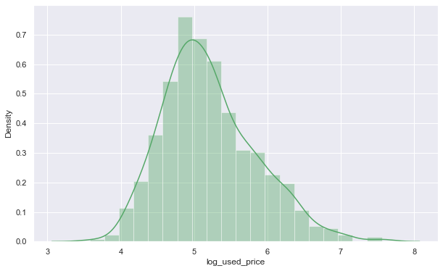
EDA
What is the distribution of budget phones offering greater than 8MP selfie cameras across brands?
the distribution of budget phones offering greater than 8MP selfie cameras across brands is normal in compere to previews plot it is not very skewed to the right

Slide 13
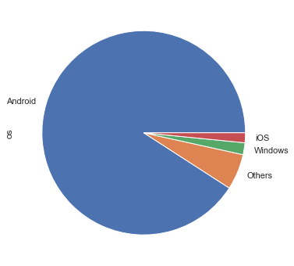
EDA
What percentage of the used phone market is dominated by Android devices?
around 90% of the used phone market is dominated by Android devices

Slide 14
Model Performance Summary
Overview of ML model and its parameters
Create Dummy Variables for 3 columns: 4_5g , os and brand_name
since ram column has just one value(4.000) I will delete it.
Then I split the data:
independent variables
x = all my data but: log_used_price, 4_5g_other, os_Others, brand_name_Xiaomi and ram
dependent variable
y = log_used_price

Slide 15
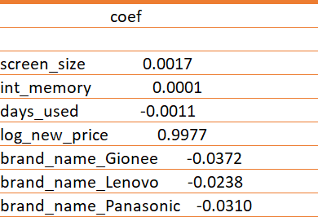
Model Performance Summary(statsmodel)
There is negative relationship between used_ price, days_used, some brand name like Gionee, Panasonic and Lenovo. It means for example, for every unit increase in days_used (one day) there is a 0.0011€ decrease in used_price.
1 unit increase in int_memory(GB) leads to an increase in used_price by 0.001€.
1 unit increase in screen_size (cm) leads to an increase in used_price by 0.001788€.
1 EURO increase in log_new_price (price of new cell phone) leads to increase in used_price(used cell phones) by 0.99€.

Slide 16
Model Performance Summary
Training Performance
Test Performance
The model can explain ~99% of the variation in the data, which is very good.
The train and test RMSE and MAE are low and comparable. So, our model is not suffering from overfitting.
The MAPE on the test set suggests we can predict within 0.07% of the used cell phone price.
Hence, we can conclude the model olsmod2 is good for prediction as well as inference purposes.

Slide 17
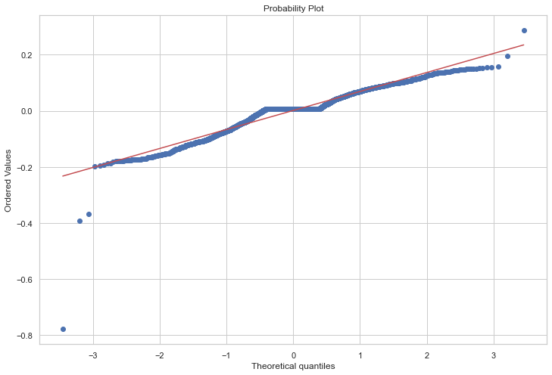
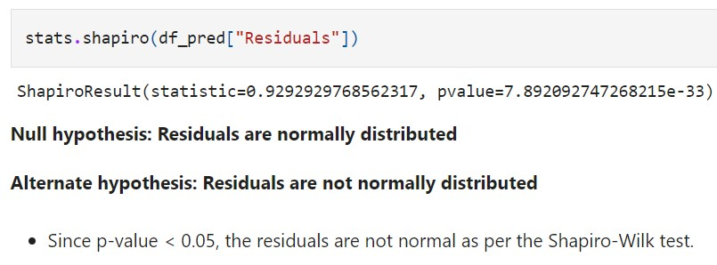
Check the assumptions
1- TEST FOR NORMALITY
Since p-value < 0.05, the residuals are not normal as per the Shapiro-Wilk test.
Strictly speaking, the residuals are not normal. However, as an approximation, we can accept this distribution as close to being normal.
So, the assumption is satisfied.

Slide 18
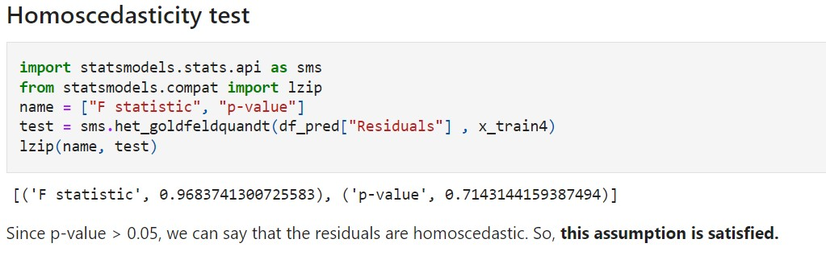
Check the assumptions
2- Test for Homoscedasticity
Null hypothesis: Residuals are homoscedastic
Alternate hypothesis: Residuals are not homoscedastic

Slide 19
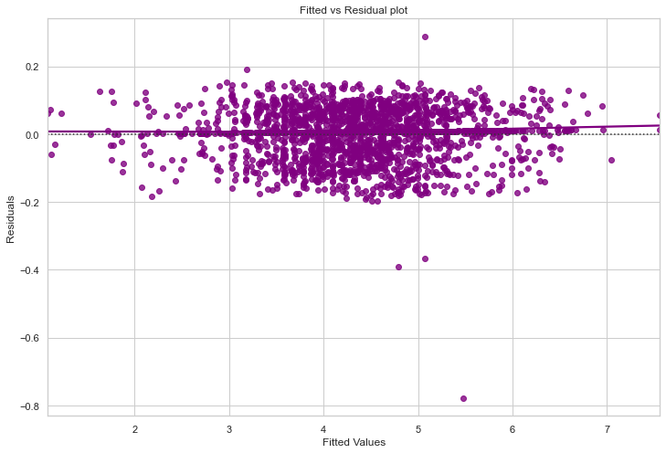
Check the assumptions
3- Test for linearity
We see no pattern in the plot above. Hence, the assumptions of linearity and independence are satisfied

Slide 20
Check the assumptions
4- Multicollinearity
I checked Multicollinearity using VIF method to remove variable which were highly correlated like
The variables which have VIF much greater than 5, are correlated with each other. here we have brand_name_Apple, release_year & os_iOS greater than 5.

Slide 21
Business Insights and Recommendations
The model can be used for predictive purposes as it can make predictions within ~7% of the actual price.
ReCell should look to attract people who want to sell used phones which have been released in recent years and have not been used for many days.
They should also try to gather, and put-up phones having a high price for new models to try and increase revenue.
They can focus on volume for the budget phones and offer discounts during festive sales on premium phones.
Additional data regarding customer demographics (age, gender, income, etc.) can be collected and analyzed to gain better insights into the preferences of customers across different segments.

